Slide 1

Save Electricity
Educational Android Game for children

Slide 2
Aim & Scope
Aim
Develop an educational game for children about the concept of saving electricity.
Scope:
Develop Android game for 4-6 year olds with interact-able objects and level progression.
2D style Game
Voice/audio support

Slide 3
Idea
Quiz like game with audio instead of texts
Level progression
2D Style
Some animation

Slide 4
Literature Analysis
Save the Power
Defenders of Nature
Nature Warrior
Save Water
Protect the Tree
Garden Game
Jungle Doctor
Save Water & Earth

Slide 6
Literature Review Conclusion
What we liked and want to implement:
Visual art theme for children
Animations
Simple Interface
Rewards
Multiple levels
What we did differently:
Voice feedback
Target 4-6 years old

Slide 7
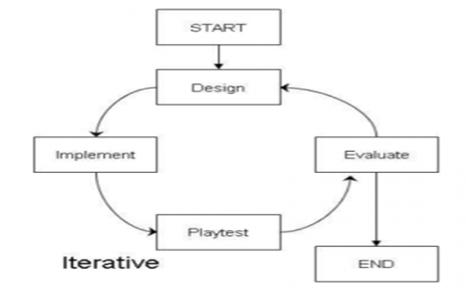
Methodology: SDLC Spiral Model

Slide 8
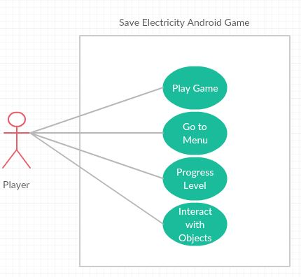
Use Case

Slide 9
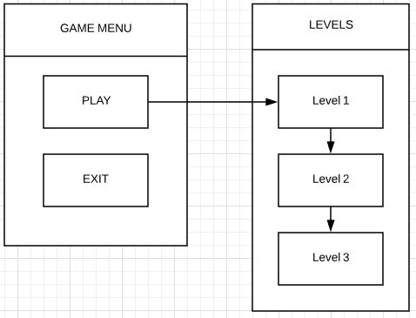
Overall Navigation

Slide 10
Game Menu

Slide 11
LEVEL START

Slide 12
Level complete screen

Slide 13
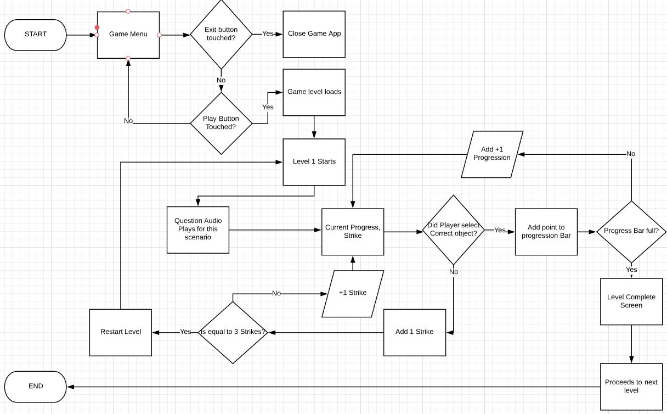
Flowchart

Slide 14
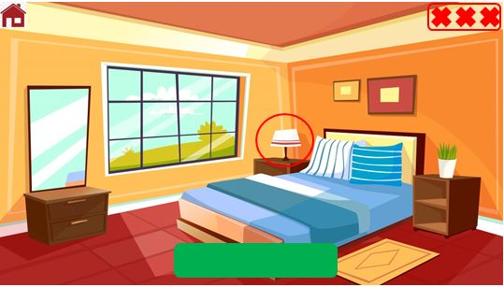
Example

Slide 15
Resources
Software:
Unity
Visual Studio
Photoshop
Hardware:
PC desktop
Android device

Slide 16
Project Risks
Lack of game developing experience
Dependent on assets
Time constraint

Slide 17
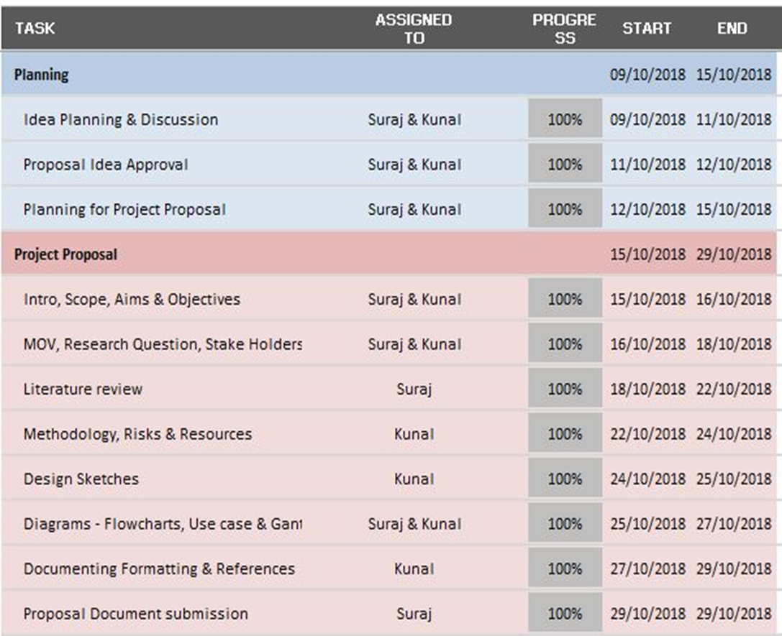
Our Progress

Slide 18
Questions?

